Slide 1
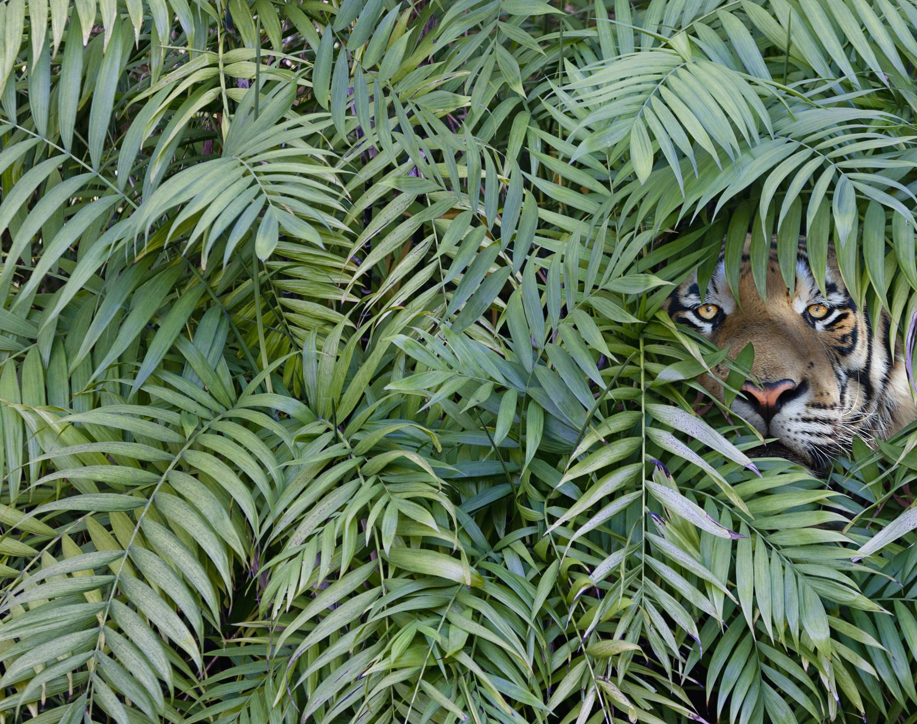
Biodiversity in National Parks
Presented by: Justice Chukwuemeka
Last Updated: June 13th, 2024

Slide 2

Agenda
Project Overview
Data Sources/Description
Data Characteristics
Key Findings
My Recommendations

Slide 3
Project Overview
What are we talking about?

Slide 4
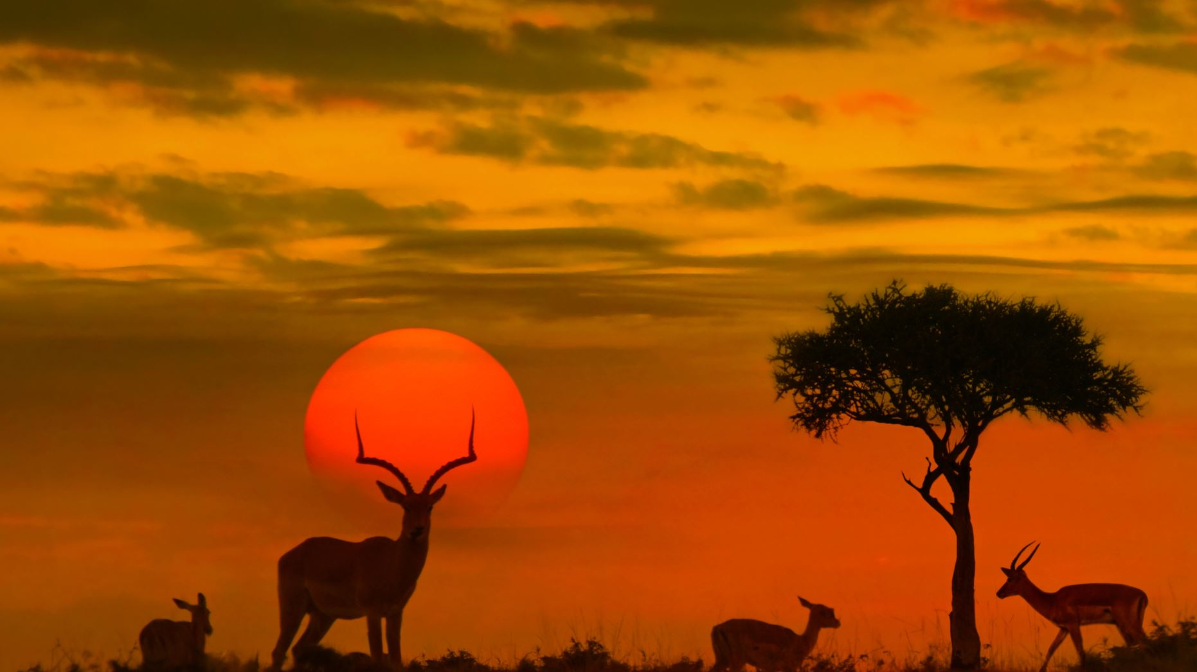
Data analysis on the conservation statuses of animal species and an investigation on any patterns or themes to the types of species that become endangered.

Slide 5
Data
What data was used?

Slide 6

2 data files, observations.csv and species_info.csv
Observations.csv hold recorded sightings of different species at several national parks for the past 7 days.
Species_info.csv contains information about different species and their conservation statuses
Data made available by Codecademy.

Slide 7
Data Characteristics
What do we know about our data?

Slide 8

There are 5,541 different species in the dataset
Species are spread across 7 categories:
Mammal, Bird, Reptile, Amphibian, Fish, Vascular plants, Nonvascualr plants.
80% of species are vascular plants
The Conservation statuses of species are:
No intervention: no concern
species of concern: declining or appear to be in need of conservation
endangered: seriously at risk of extinction
Threatened: vulnerable to endangerment in the near future
In recovery: formerly endangered, but currently not in danger of extinction

Slide 9
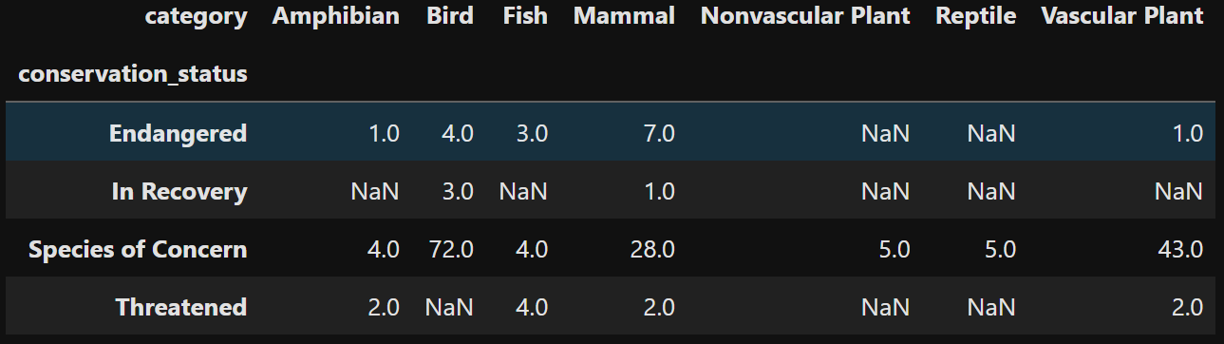
Species in the mammal and bird categories are more endangered.
Birds are bouncing back better than the mammals because 3 species of birds are “in recovery” compared to 1 specie of mammal.

Slide 10
Statistical Significance
How significant is the differences in conservation status?

Slide 11
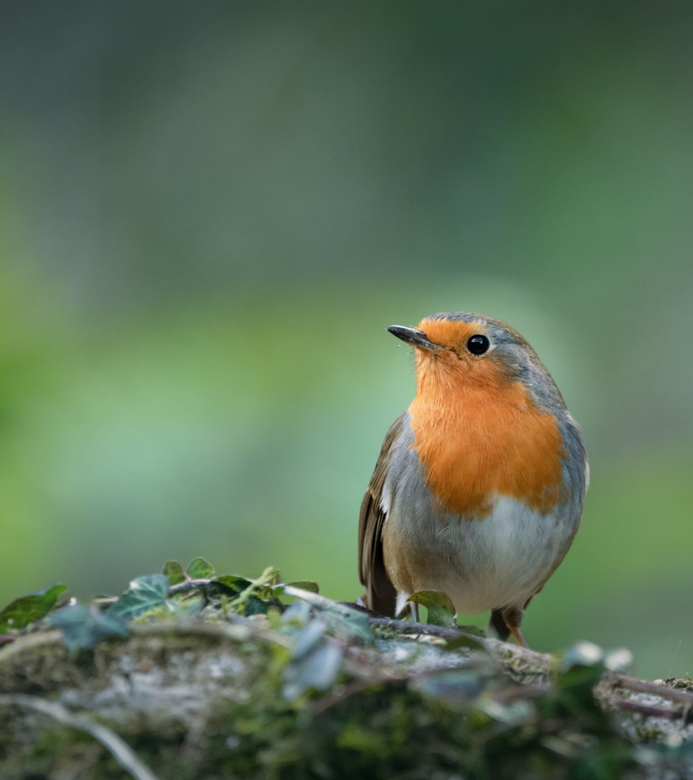
The observed difference in conservation statuses of mammals and birds is likely due to chance rather than a specific cause.

Slide 12

The observed difference in conservation statuses of mammals and reptiles is significant. Mammals are shown to have a statistically significant higher rate of needed protection compared with reptiles. So, it is not by chance that a higher number of mammals are endangered than reptiles.

Slide 13
My Recommendations
For Conservationist concerned about endangered species

Slide 14
Given the statistically significant higher rate of endangered mammals compared to reptiles, it is crucial to allocate more resources and efforts towards mammal conservation programs.
Increase monitoring of mammal populations to gather more data on their status. This can help in making more informed conservation decisions.
Advocate for stronger policies and regulations that protect endangered mammals, including stricter anti-poaching laws and better enforcement of wildlife protection laws.

